Slide 1




PUB MANAGEMENT SOFTWARE
GROUP 8
Superviors:
HOANG VAN HIEU
Class:
231.ITE1264E.A04E

Slide 2

DUTY CHARTS
NAME | WORK | PERCENT
NGUYEN VAN MANH | Login, sales management, billing, desk, sales invoice | 50%
DUONG KIM TUYEN | Employee management, salary statistics, reporting | 25%
TRUONG THI NGOC NHU | Costumer management, menu management, power point | 25%
1
03
04
05

Slide 3
CONTENTS
01
ABSTRACTS
02
TECHNOLOGY LOGO
03
FUNCTIONAL DIAGRAM OF THE SYSTEM
04
DATABASE DESCRIPTION
05
Interface

Slide 4


ABSTRACTS
Currently, technology is present in all fields of industry, becoming a popular, useful labor tool and playing a very important role in life. Talking about technology, there are hundreds of applications and utility systems. Among them can be mentioned information management systems and services. Through that system, we can easily batch manage a database efficiently, easily and quickly. It helps users save time thoroughly and avoid unnecessary mistake.

Slide 5




TECHNOLOGY LOGO
SQL Server Management Studio 19 #1
Visual Studio 2022 #2
Microsoft SQL Server is a relational database management system that provides a way to organize data by saving them to tables. Relational data is stored in tables, and those relationships are defined between tables.
Microsoft Visual Studio is an integrated development environment from Microsoft. It used to develop computer programs for Microsoft Windows, as well as websites, web applications and web services.

Slide 6
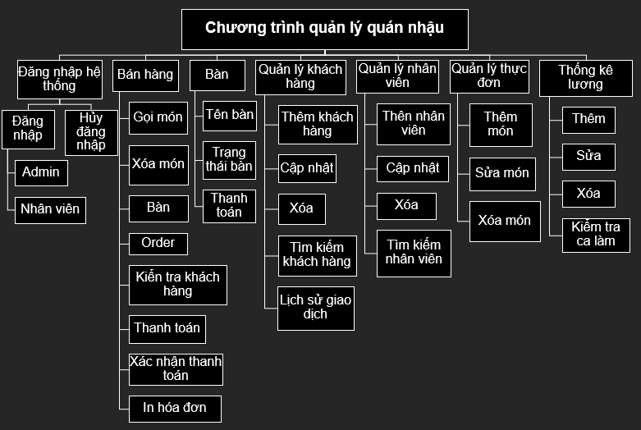

Slide 7



NHANVIEN(MaNV,TenNV,Gioitinh,SDT,Chucvu,Ngaysinh)
CALAMVIEC(MaNV,Ngay)
LUONGNHANVIEN(MaNV,Tongluong,Kyluong)
TAIKHOAN(Tendangnhap,Matkhau,QuyenHan,MaNV)
DATABASE SCHEMA
KHACHHANG (MaKH,TenKH,SDT,LoaiKH,DiemTL)
MONANDABAN(MaHDBH, MonAn,SoLuong,GiaTien)
THUCDON (MonAn,GiaTien,LoaiHang)
BAN(Tenban,Trangthai)
DATHANG(Tenban,SDT,MonAn,SoLuong,Giatien,Thanhtien)
HOADONBANHANG( MaHDBH, MaNV,Tenban,MaKH,NgayHDBH,Thanhtien,VAT,DiemTL,Giamgia,Tongtien)

Slide 8


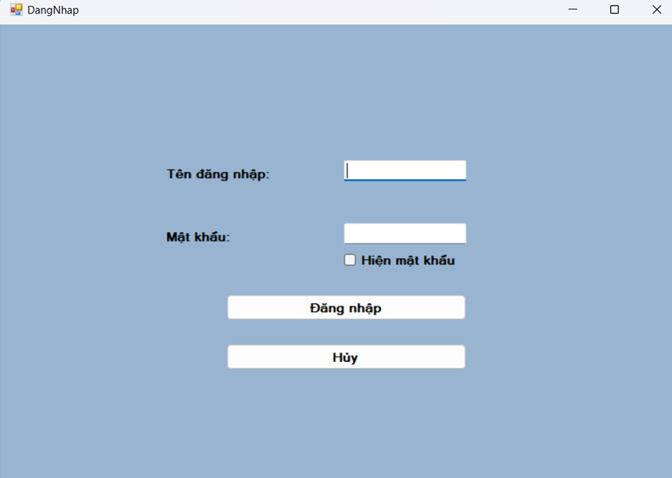
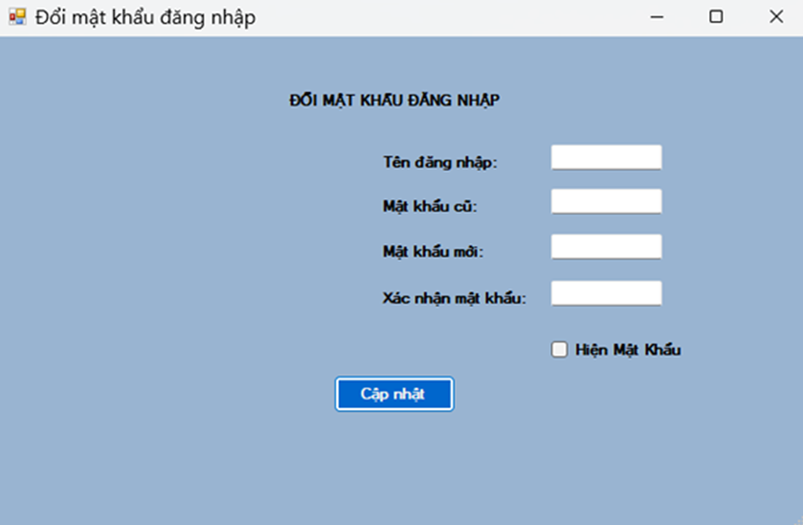
LOGIN INTERFACE

Slide 9

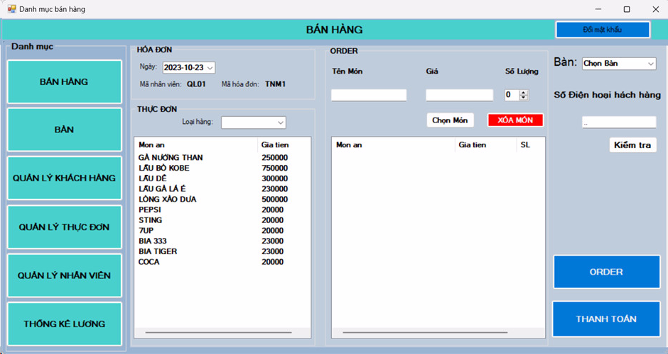
MAIN INTERFACE

Slide 10
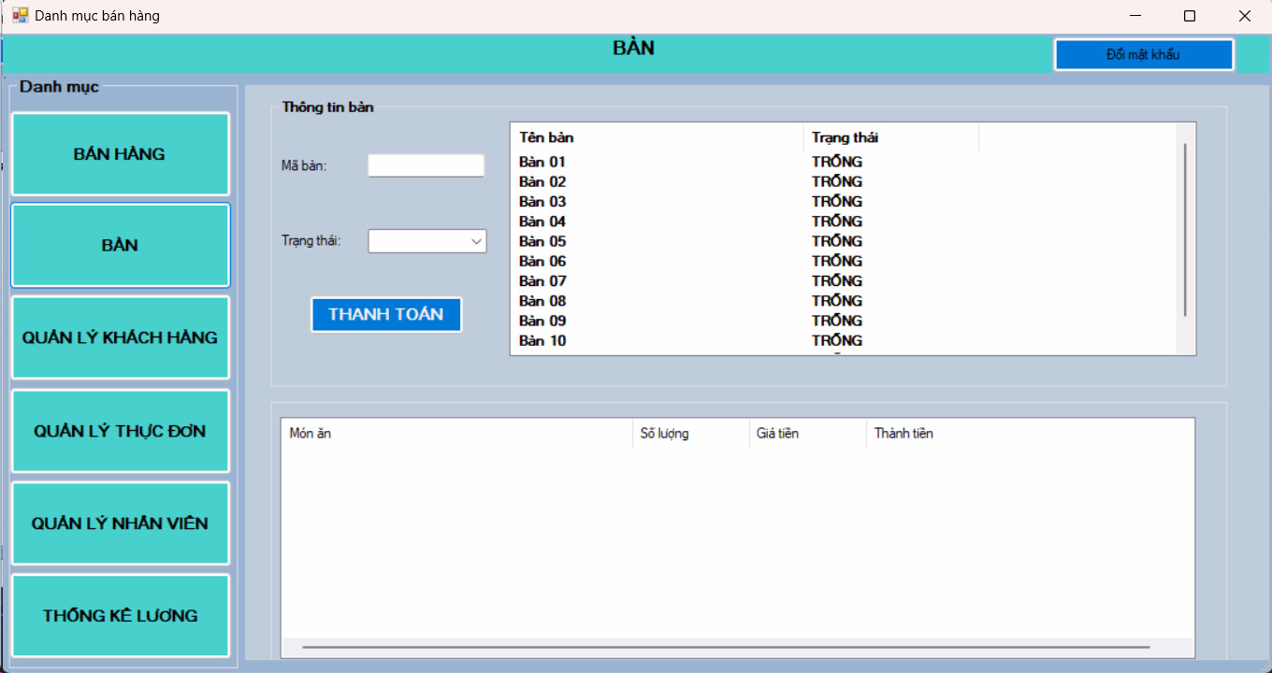
TABLE INTERFACE

Slide 11
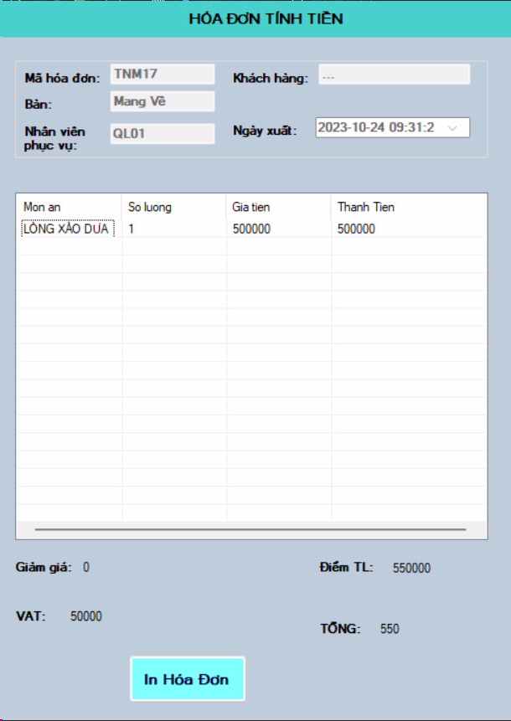
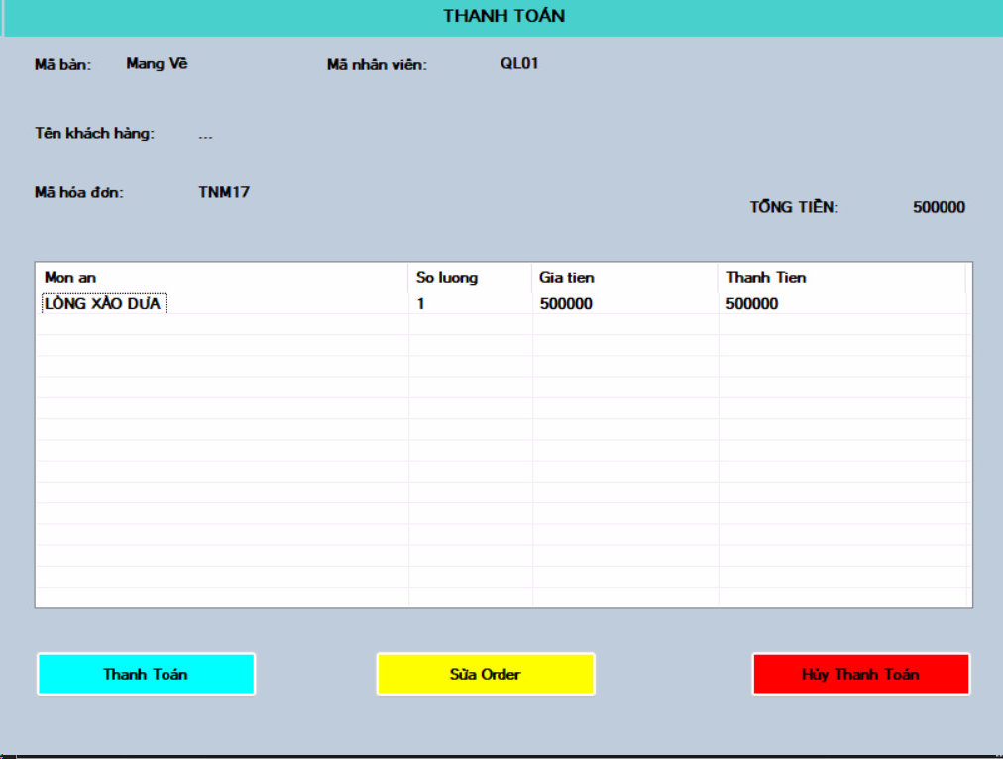

Slide 12
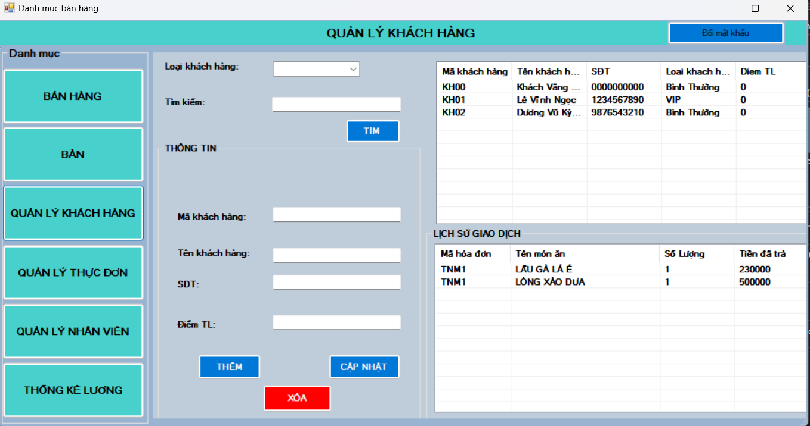
COSTUMER INTERFACE

Slide 13
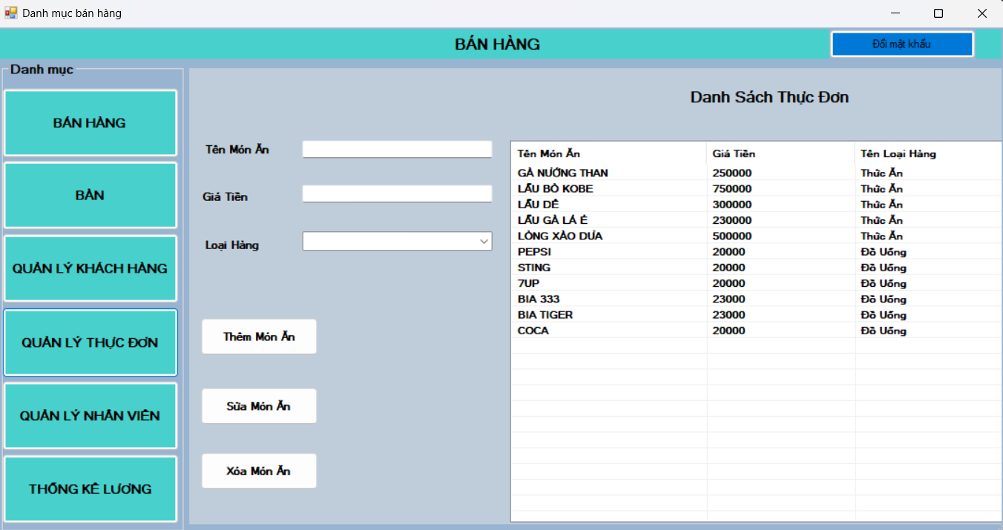
MENU MANAGEMENT INTERFACE

Slide 14
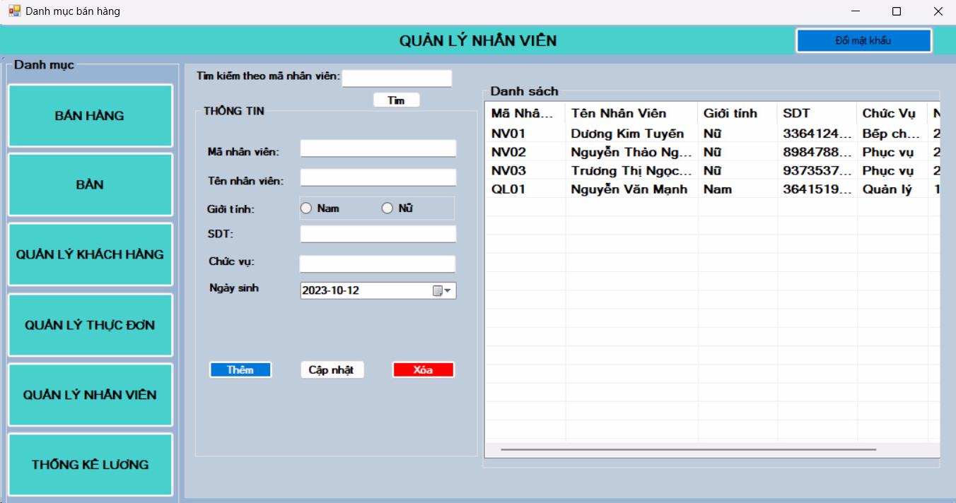
EMPLOYEE MANAGEMENT INTERFACE

Slide 15
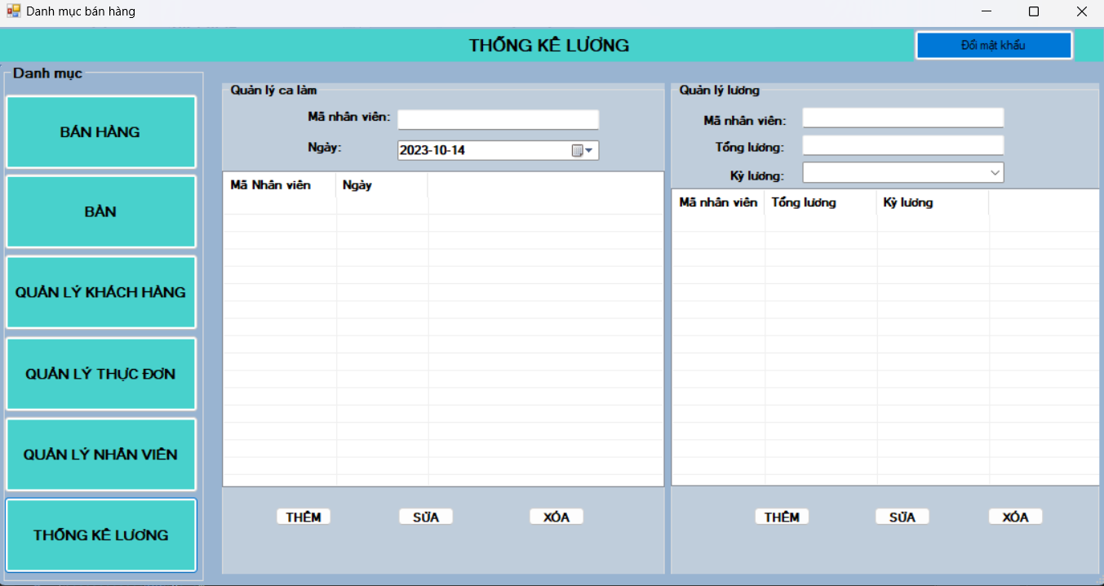
EMPLOYEE SALARY MANAGEMENT INTERFACE

Slide 16


